Slide 1





Introduction to
Arduino
Electronics and Robotics Club

Slide 2
Introduction to
Arduino
Electronics and Robotics Club

Slide 3


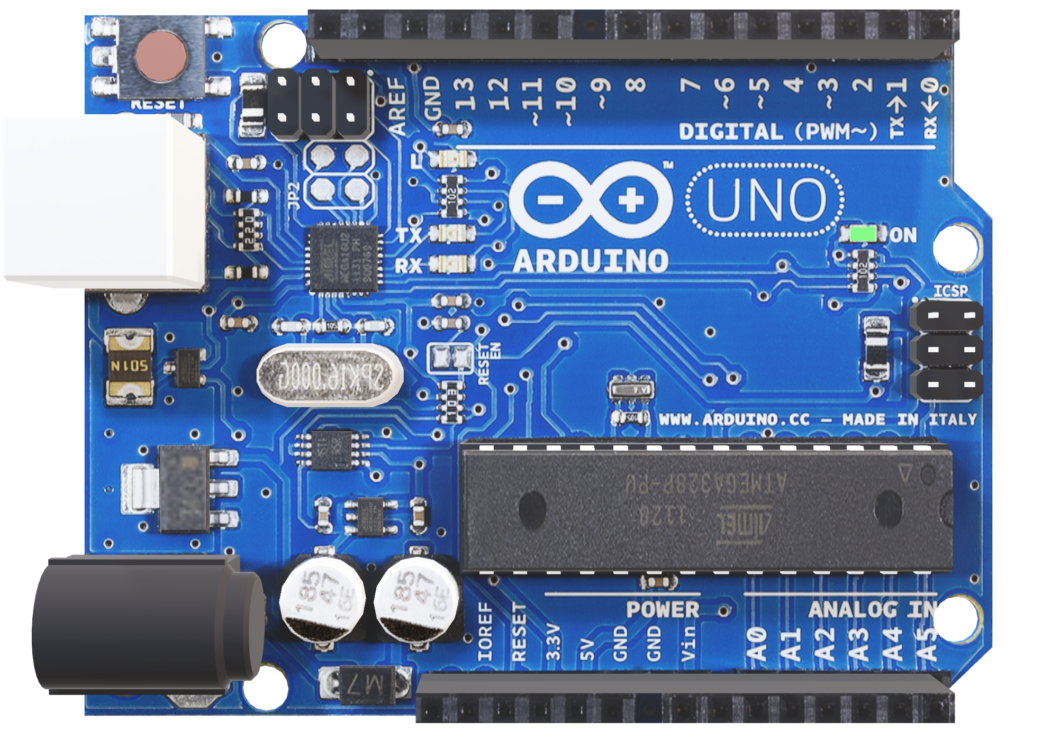
01
Basics of Arduino
Arduino is a small controller that you can use to create all sorts of cool and fun projects.
An Arduino is like your little smart friend. You write a set of instructions in a special language
that it understands (code), and then you upload that code to the Arduino. Once it has the
instructions, it starts doing whatever you told it to do.
Let's say, we have to sense some movement. A motion sensor can be attached to it and it
will send data to Arduino. Now, this data can be used to control a motor controlled door.

Slide 4

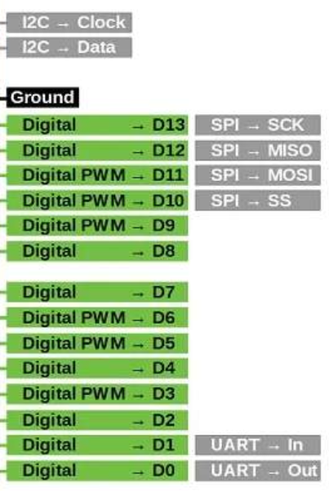
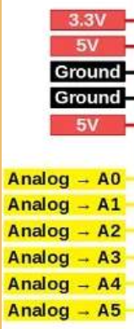

Pinout
Diagram

Slide 5
02
What do the various pins do?

Slide 6
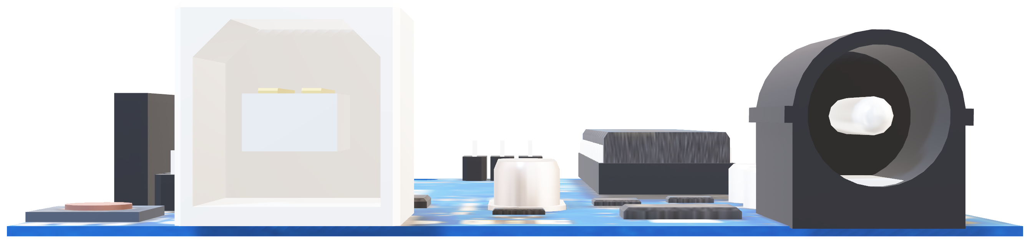
USB-in: You connect your Arduino to
the laptop through this.

Slide 7

Built-in LED: Digital-pin 13 by default has an
LED attached to it, which glows
when you give power to this pin.
Digital pins: Used to input/output digital
signals.

Slide 8
Voltage pins: 5V (VCC), GND (ground), 3.3V. These are
power sources which provide fixed
voltage to your circuit.
Analog pins: Used to input/output analog
signals.

Slide 9
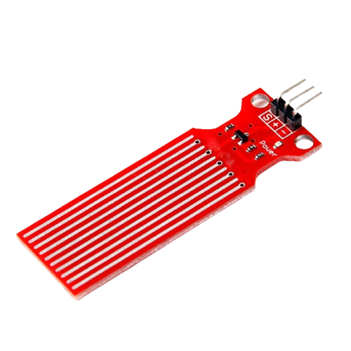
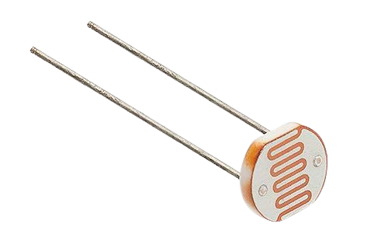
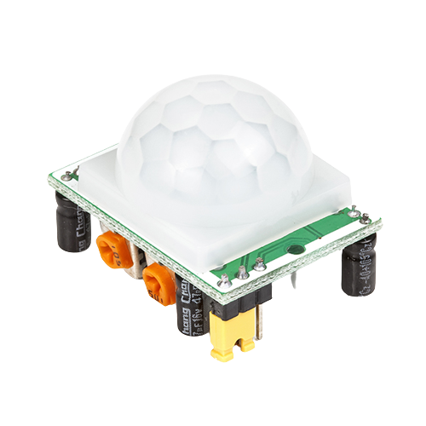
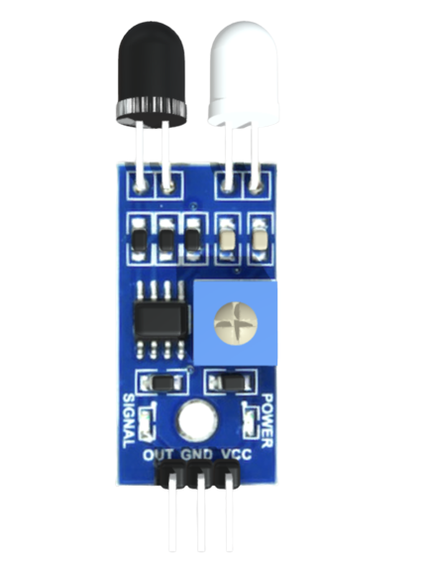
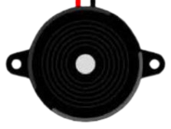
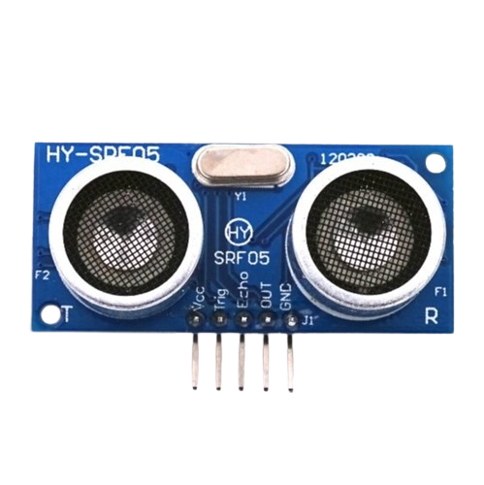
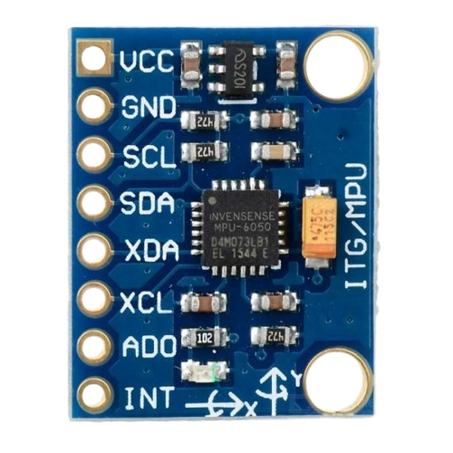
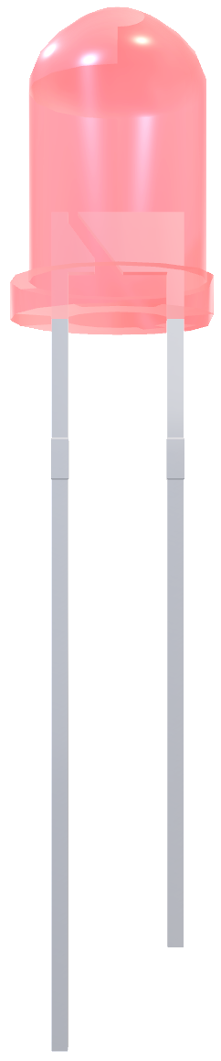
03
Some other
Basic components
We’ll explore how to use basic components, such as LEDs and breadboards, to create basic circuits with Arduino.

Slide 10
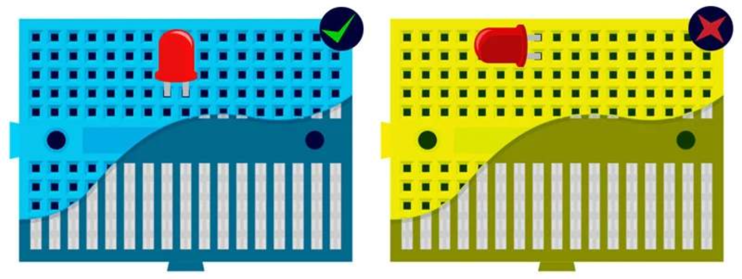
1. Breadboard

Slide 11
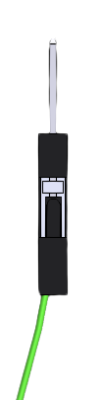
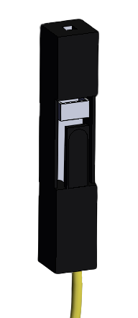
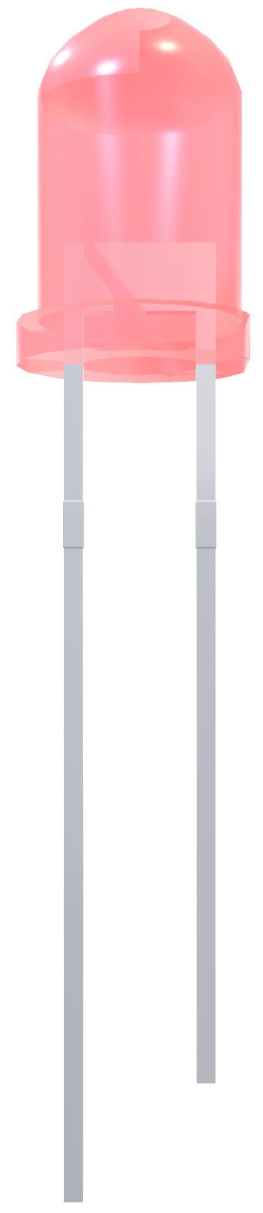
2. LED
3. Wires
Male to Female
Female to Female
Cathode
GND
Ground
Male to Male
Anode
VCC
(Voltage Common Collector)

Slide 12
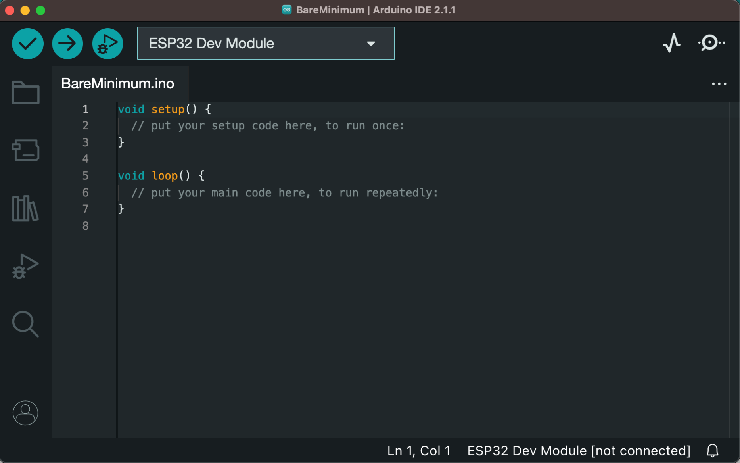
Arduino IDE
IDE (Integrated Development Environment) is an official software by Arduino.cc used for writing, compiling, and uploading code to Arduino boards.
Arduino is similar to regular C++, with additional libraries for specific board functions.

Slide 13
Let’s do hands-on practice by doing some tasks………

Slide 14
Let’s do hands-on practice by doing some tasks………

Slide 15
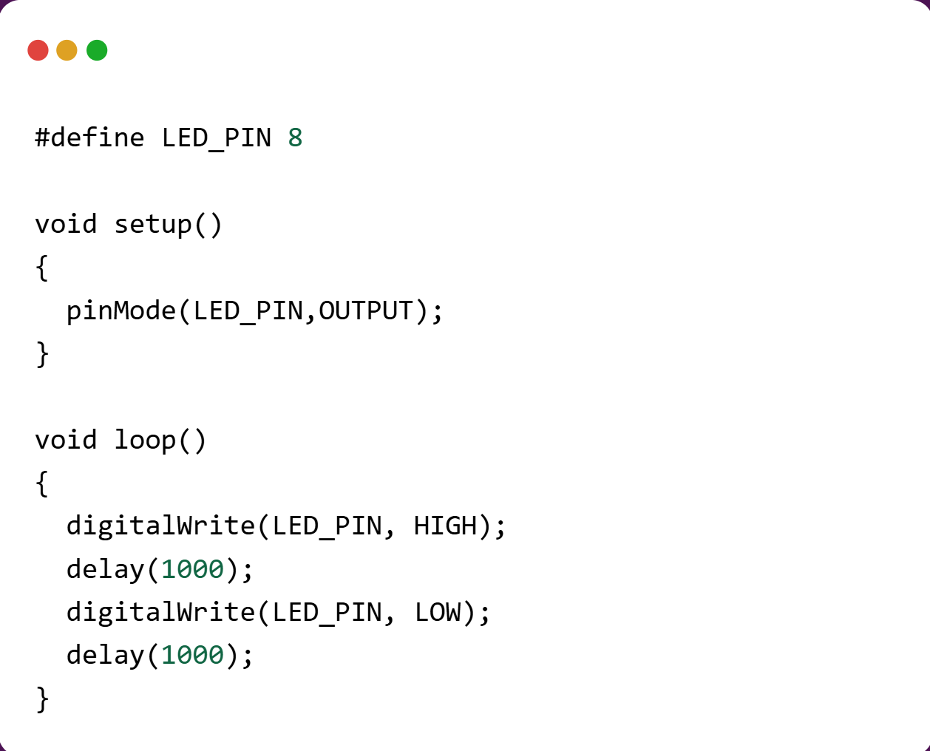
Task 1: Blink the LED
Let's explore how to make an LED blink using an Arduino. Here is the code you'll need to complete this task.

Slide 16
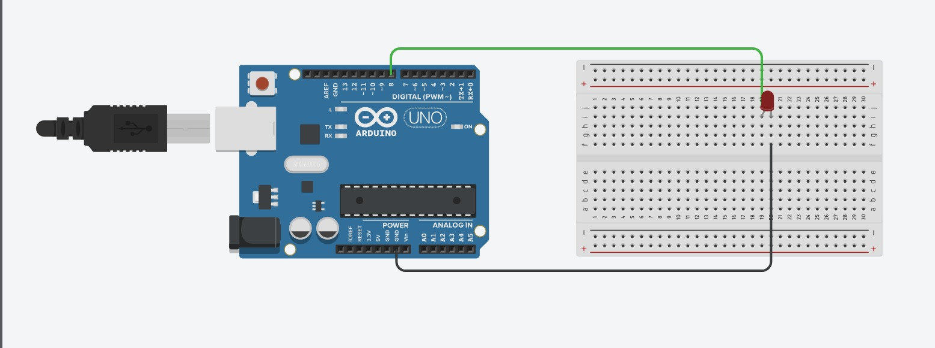
Task 1: Blink the LED
Connect VCC and GND through a resistor as shown

Slide 17
Play around with the delay values!!

Slide 18
WALL / OBSTACLE
How does IR sensor Work?
01
IR RECEIVER
IR EMITTER
The Infrared emitter first emits an infrared signal. The signal then hits the obstacle in front of it.
02
The reflected signal is detected by the IR receiver which then generates an output through the OUT pin.
OUTPUT
VCC
GND

Slide 19
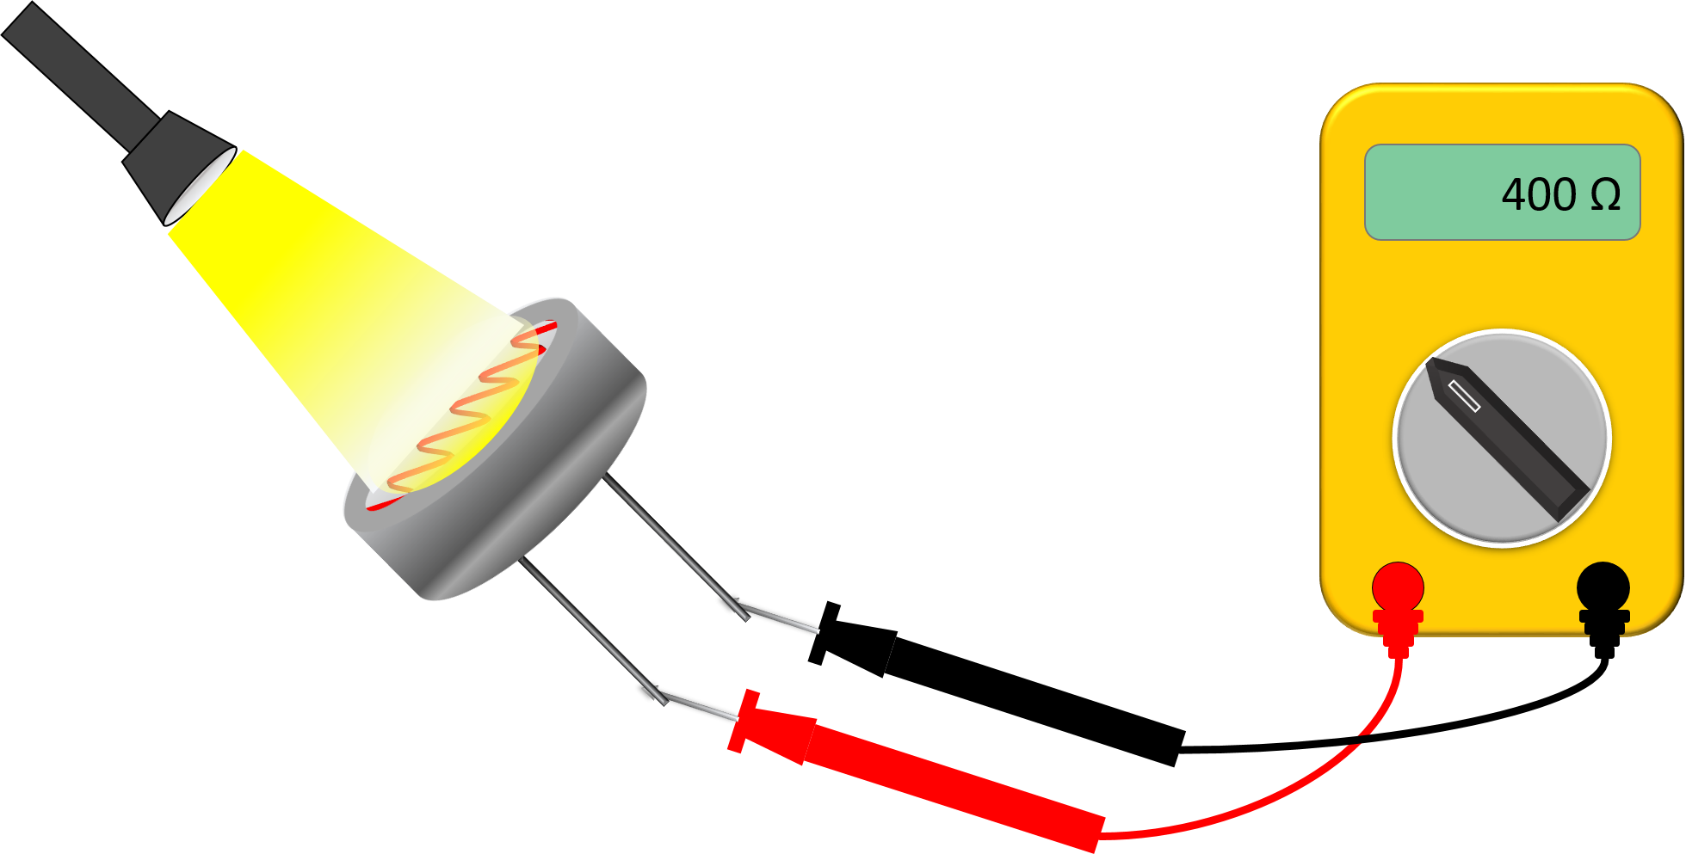
How does LDR sensor Work?
(Light Dependent Resistor)
An LDR (Light Dependent Resistor) is a sensor that changes how much it resists electrical current based on how much light hits it. In bright light, it allows more current to flow through it; in the dark, it resists current more.

Slide 20
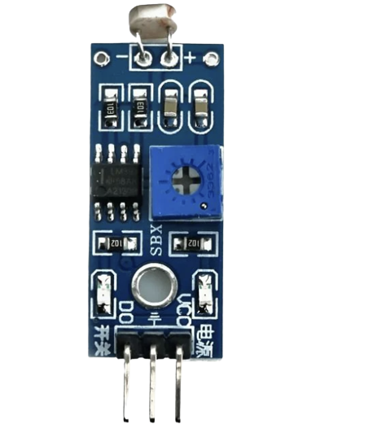
LDR Pinout Diagram
DO – Digital Output
VCC – Connected to power source (5V)
GND – Connected to common ground (0V)

Slide 21
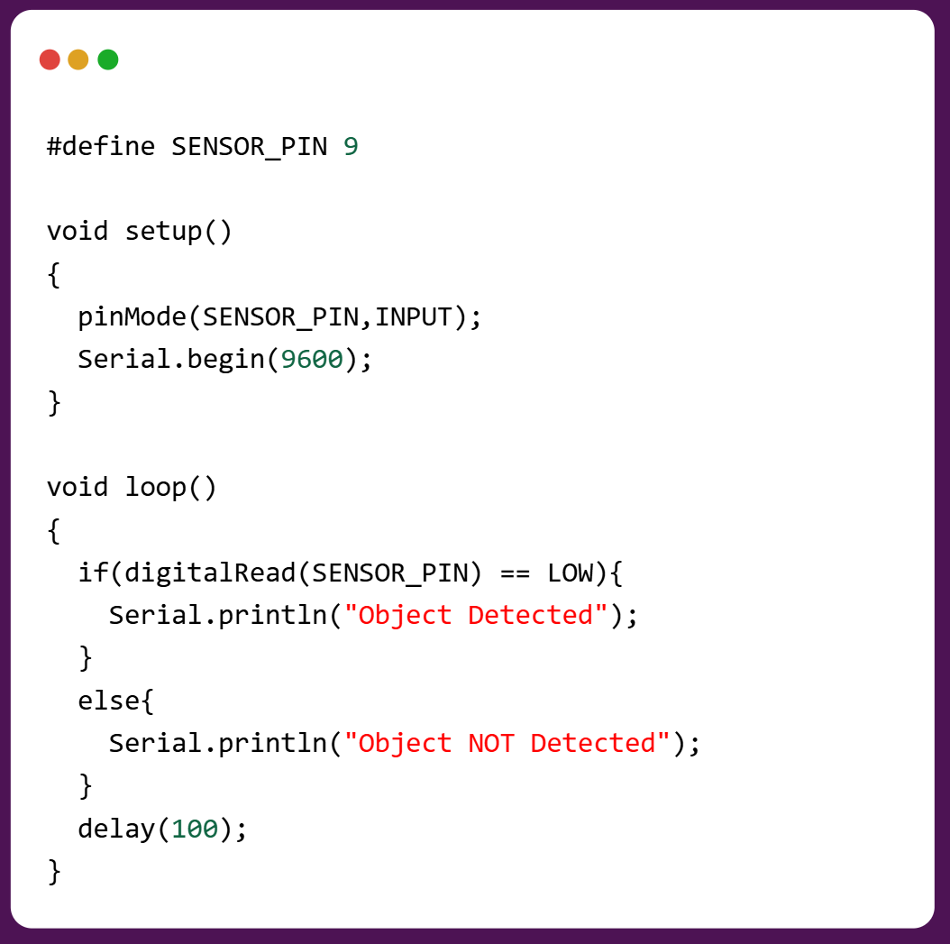
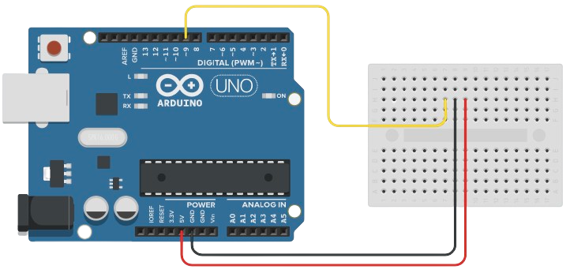
Task 2: IR/LDR sensor
01 IR

Slide 22

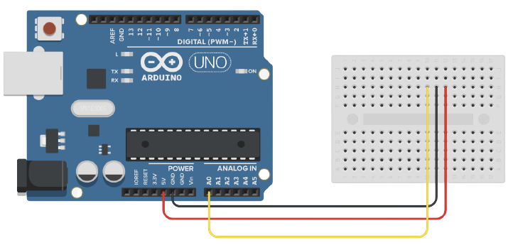
Task 2: IR/LDR sensor
02 LDR

Slide 23
Task 3 : Buzzer
In the buzzer the ground is kept connect to
the common ground always and VCC is
connected to the control pin of the Arduino
/micro-controller. When the buzzer is to be
kept silent – we provide low voltage/ground
through the pin and when we need to sound
the buzzer we provide high voltage through
the pin.
VCC
GND

Slide 24
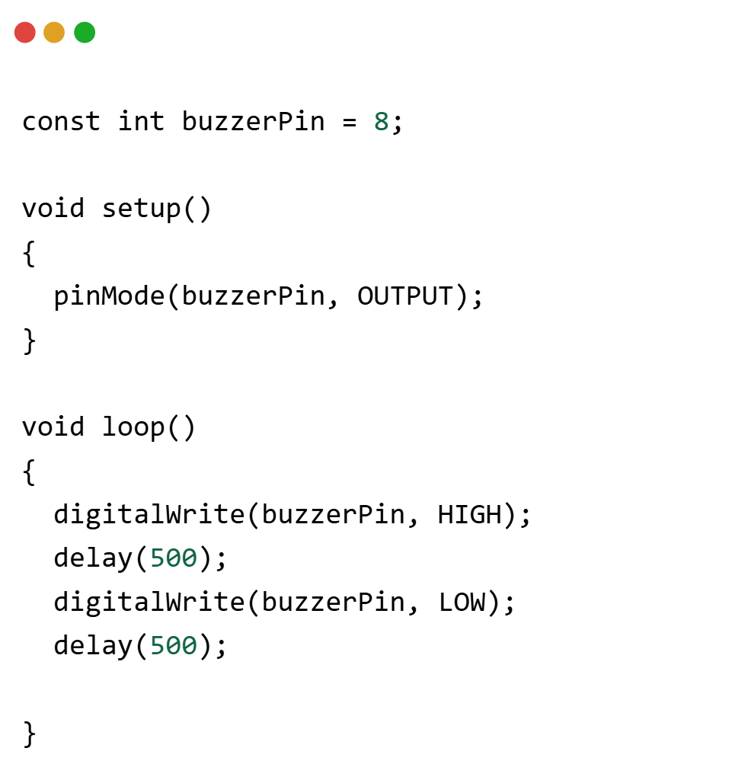
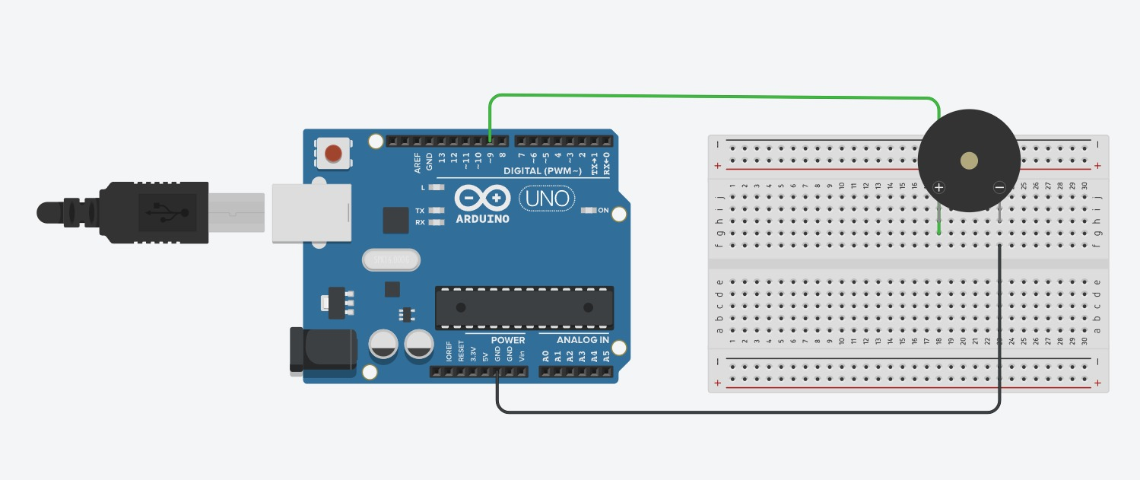
Task 3 : Buzzer
Play around with the delay values!!

Slide 25
Task 3 : Buzzer
VCC
GND
In the buzzer the ground is kept connect to
the common ground always and VCC is
connected to the control pin of the Arduino
/micro-controller. When the buzzer is to be
kept silent – we provide low voltage/ground
through the pin and when we need to sound
the buzzer we provide high voltage through
the pin.

Slide 26
Task 3 : Buzzer
VCC
GND
In the buzzer the ground is kept connect to
the common ground always and VCC is
connected to the control pin of the Arduino
/micro-controller. When the buzzer is to be
kept silent – we provide low voltage/ground
through the pin and when we need to sound
the buzzer we provide high voltage through
the pin.

Slide 27
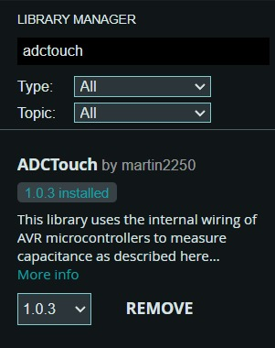
Task 4 : ADC touch sensing
Detecting touch by detecting changes in capacitance on a pin

Slide 28
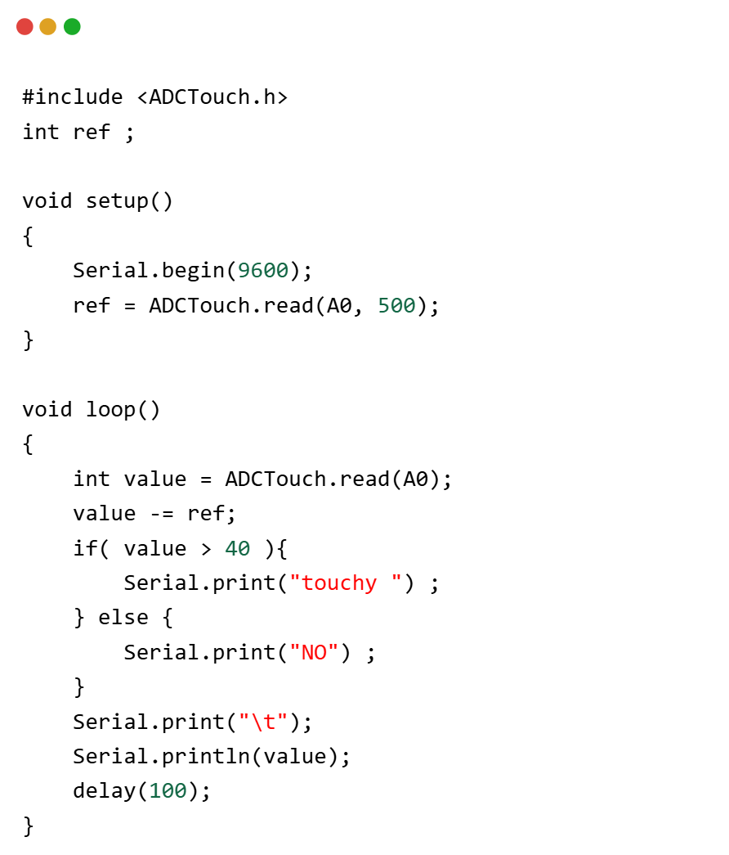
Task 4 : ADC touch sensing

Slide 29


Task 5: Capacitive touch and buzzer
Using the touch sensor and buzzer, try to create a circuit to generate a sound when the touch sensor pin is touched.

Slide 30
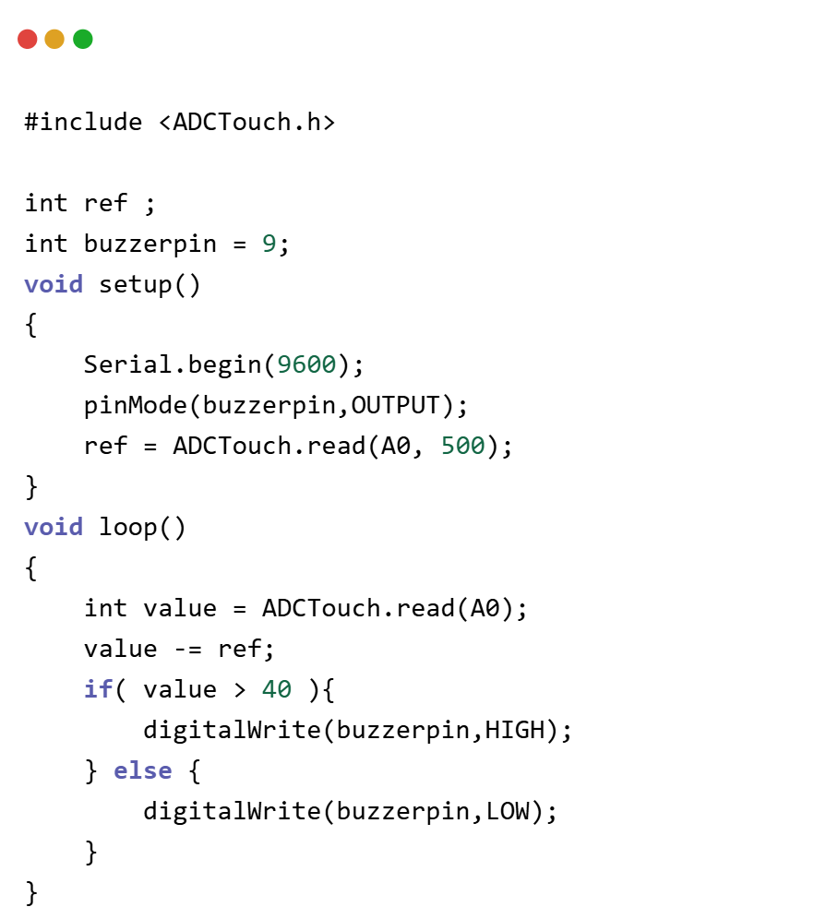
Task 5
// code for task : 4
include <ADCTouch.h>
int ref ; //reference values to remove offset
int buzzerpin = 9;
void setup()
{
// No pins to setup, pins can still be used regularly, although it will affect readings
Serial.begin(9600);
pinMode(buzzerpin,OUTPUT);
ref = ADCTouch.read(A0, 500); //create reference values to
}
void loop()
{
int value = ADCTouch.read(A0); //no second parameter
value -= ref; //remove offset
if( value > 40 ){
// Serial.print("touchy ") ;
digitalWrite(buzzerpin,HIGH);
} else {
// Serial.print("NO") ;
digitalWrite(buzzerpin,LOW);
}
}

Slide 31
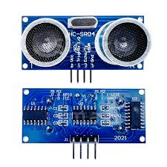
ULTRASONIC SENSOR
An ultrasonic sensor uses a transducer to send and receive ultrasonic pulses that relay back information about an object’s proximity. It can tract distances of objects High-frequency sound waves reflect across boundaries to produce distinct echo patterns.

Slide 32
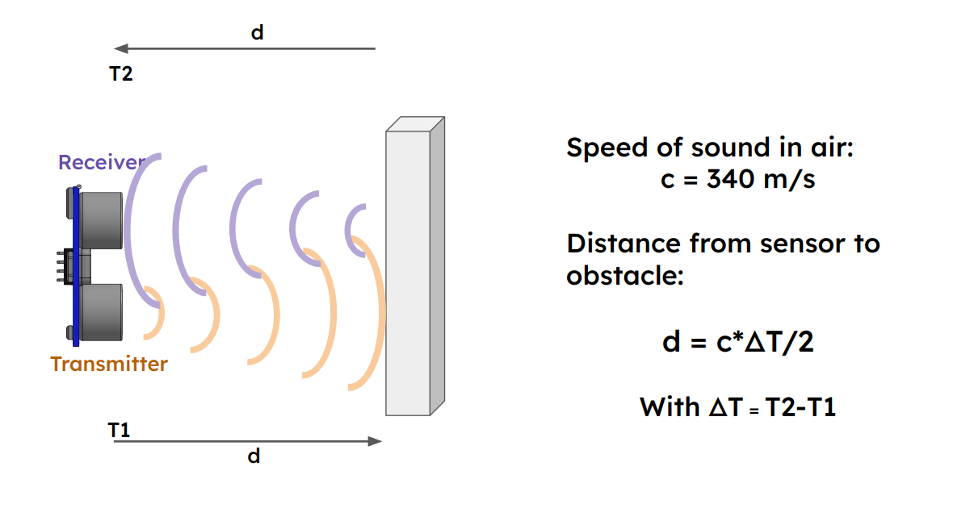
HOW ULTRASONIC SENSORS WORK
It sends out high-frequency sound waves (ultrasound) and listen for the echo that bounces back. The sensor measures how long it takes for the echo to return. By calculating this time, it can figure out how far away the object is

Slide 33
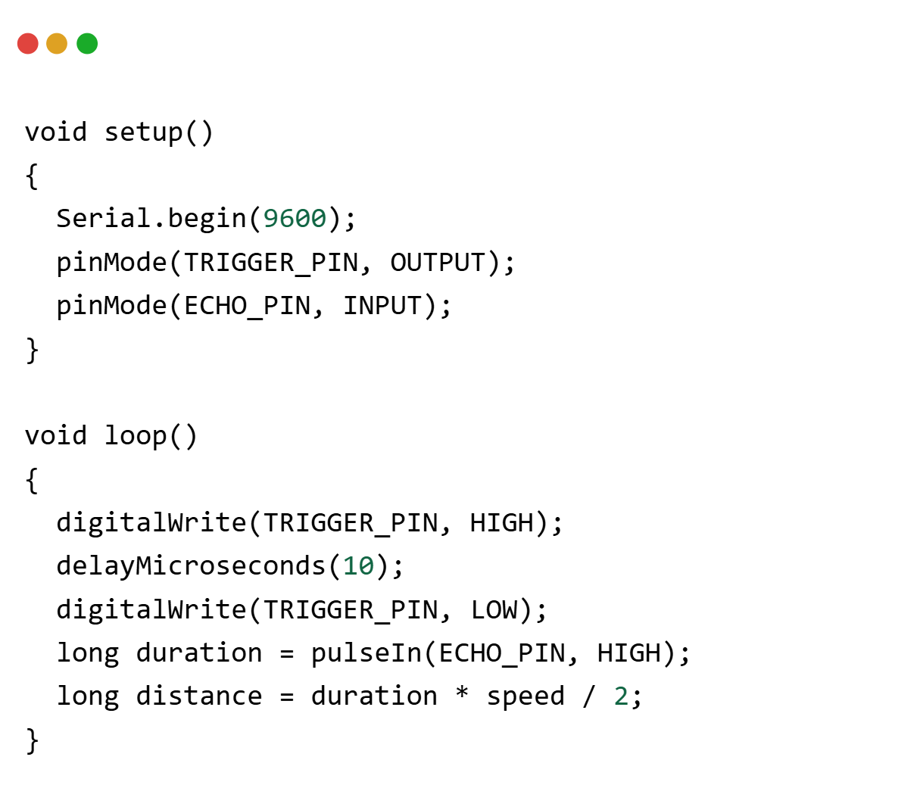
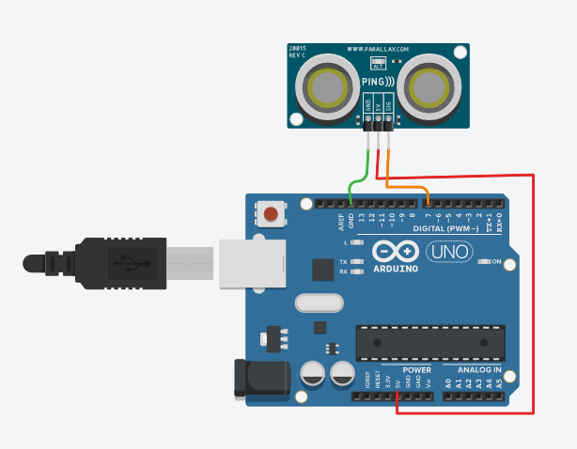
Code Snippet

Slide 34
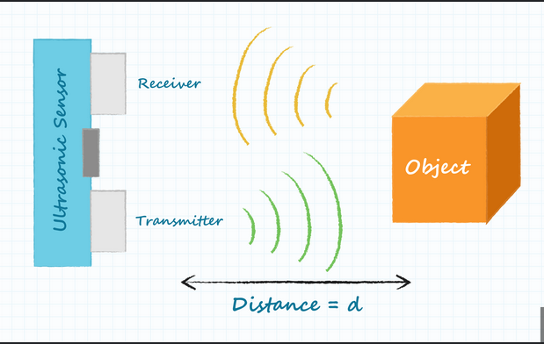
USES
The concept of ultrasound has wide applications. animals like bats and dolphins, produce ultrasound to travel and catch its prey.
bats use the concept of echolocation, to find its way in the dark. dolphins too find their food through echolocation.

Slide 35
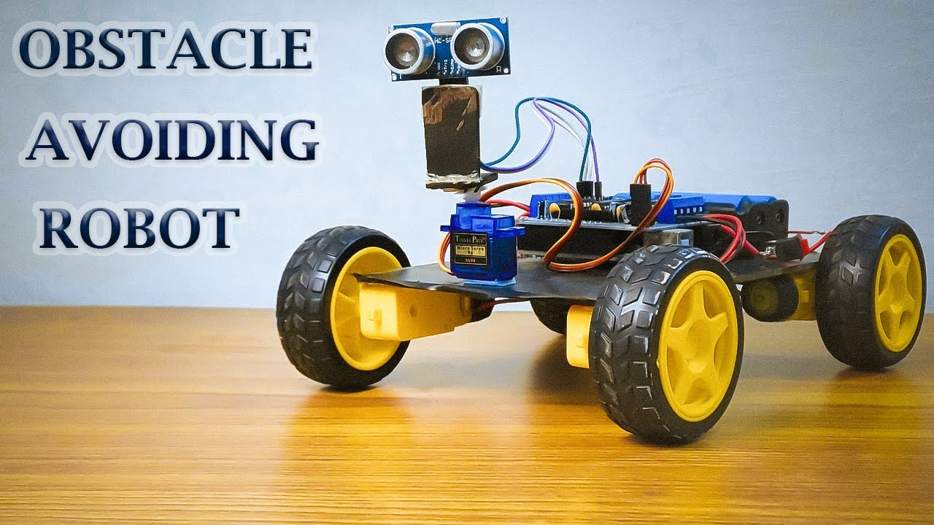
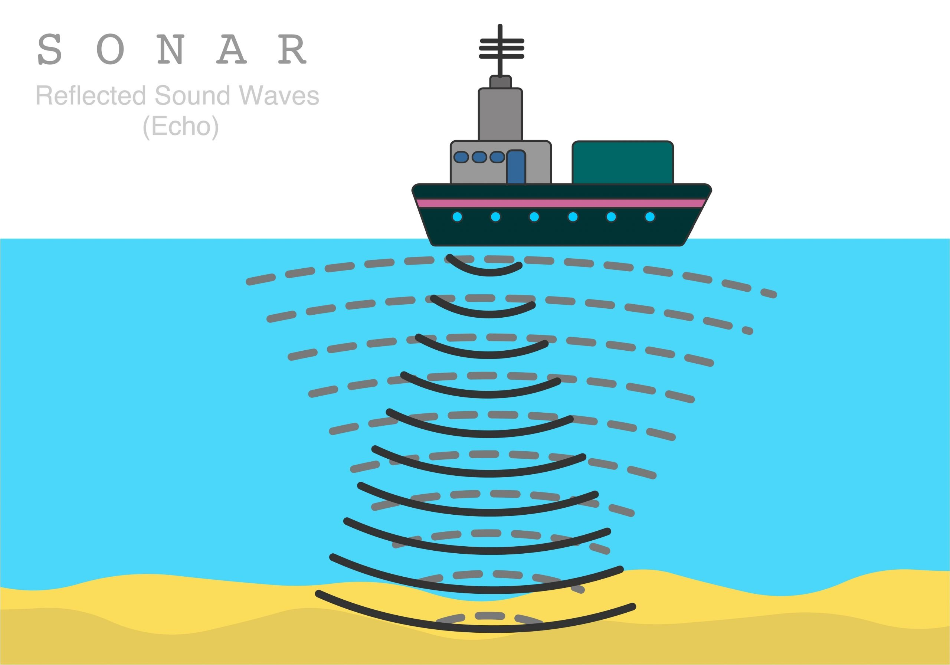
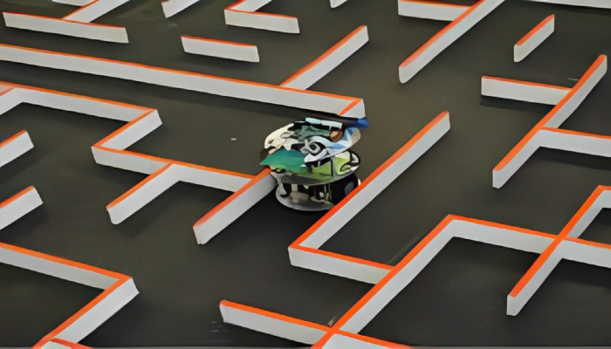
PROJECTS USING ULTRASONIC SENSORS

Slide 36
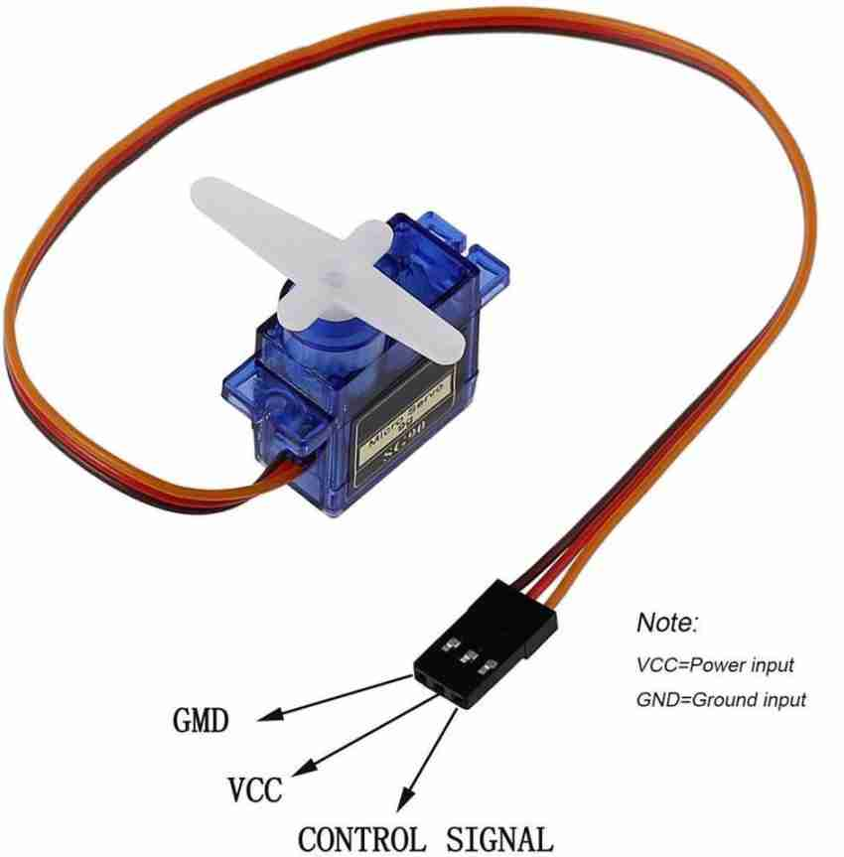
Servo Motors
A servo motor is a precise motor that can rotate to exact angles. It has a feedback system to ensure accuracy and often includes gears for high torque in a compact size. Servo motors are rated in kg/cm, indicating how much weight they can lift at a specific distance from the shaft. For example, a 6 kg/cm servo can lift 6 kg at 1 cm from the shaft, but can lift less weight at greater distances.

Slide 37
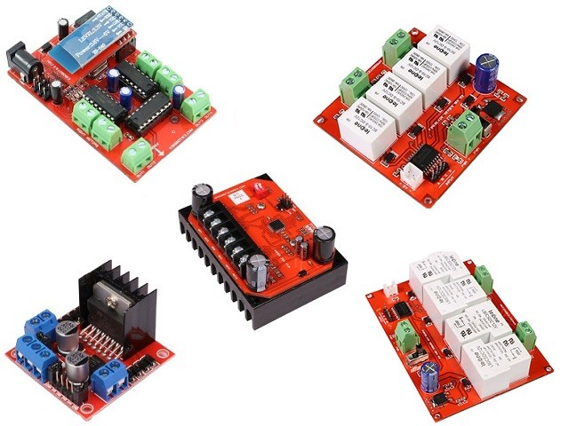
Motor Drivers
A motor driver is used instead of connecting a motor directly to a board to handle higher currents and voltages that motors require, which a board might not support. It also provides control features like speed regulation, direction changes, and protection against electrical issues.

Slide 38
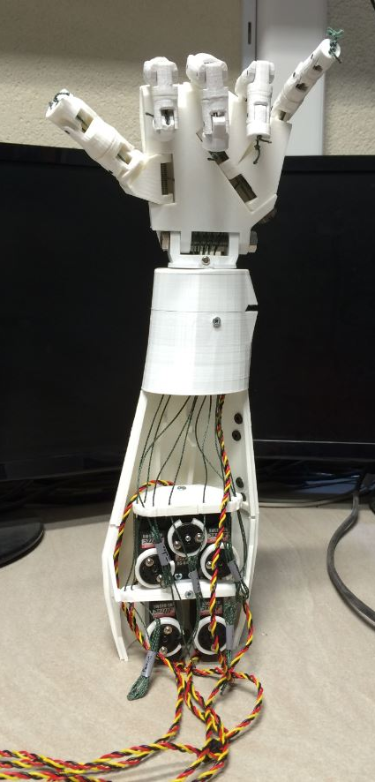
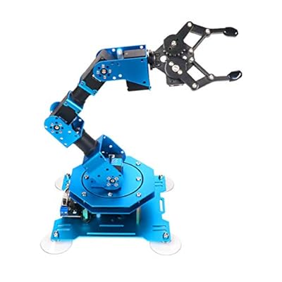
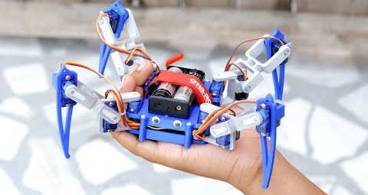
PROJECTS USING SERVO MOTORS

Slide 39
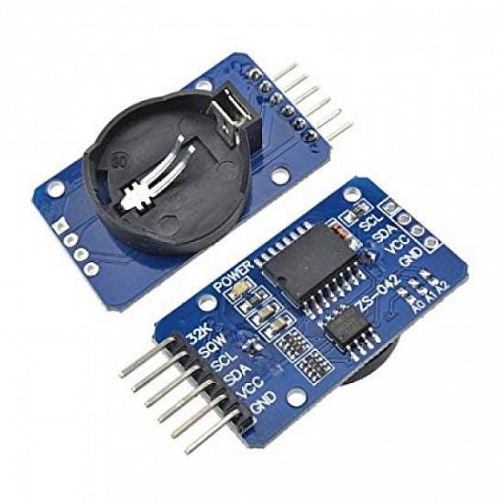
DS3231 RTC
Highly accurate, Cost-effective
Counts Hours, Minutes and Seconds
Day of the Week, Day, Month and Year
Automatic compensation for leap years and months with fewer than 31 days
2 programmable time-of-day alarms
Operating voltage from 3.3 to 5V
3V battery
Temperature compensation capabilities
I2C protocol

Slide 40
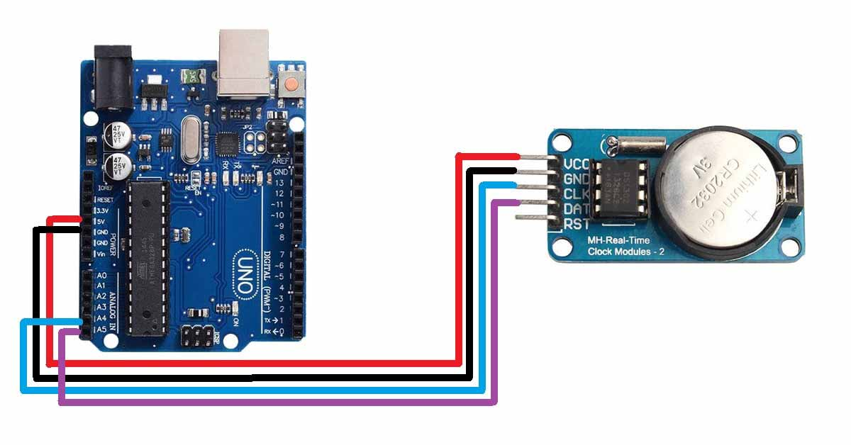
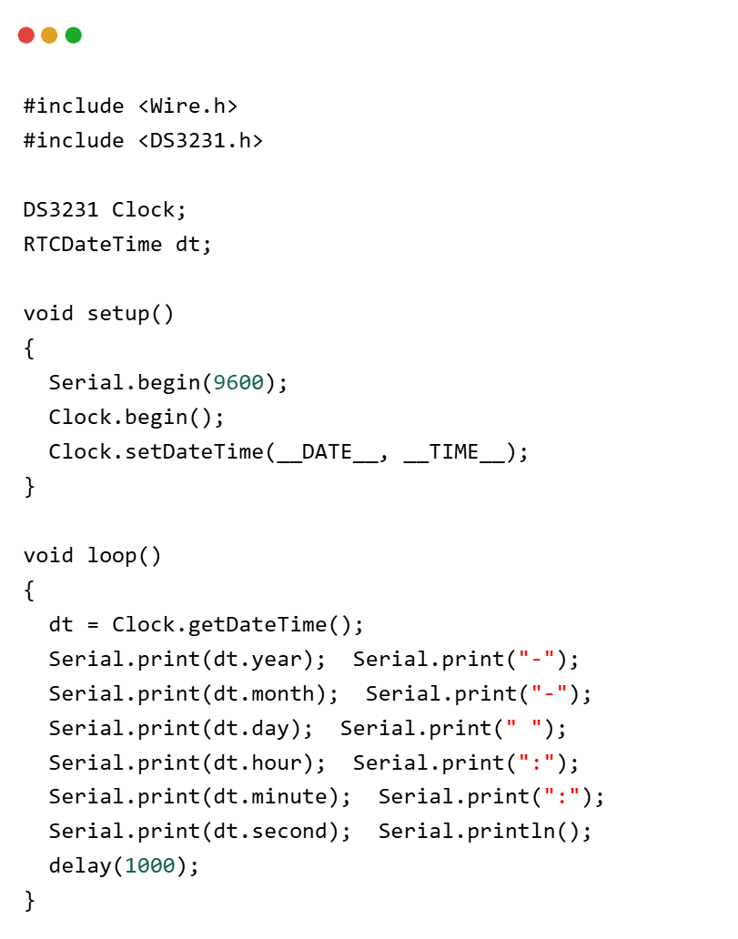
Code Snippet

Slide 41

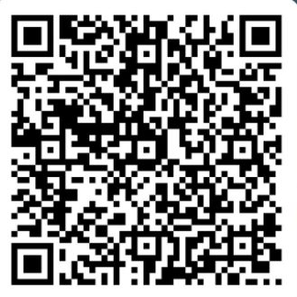
Feedback

Slide 42
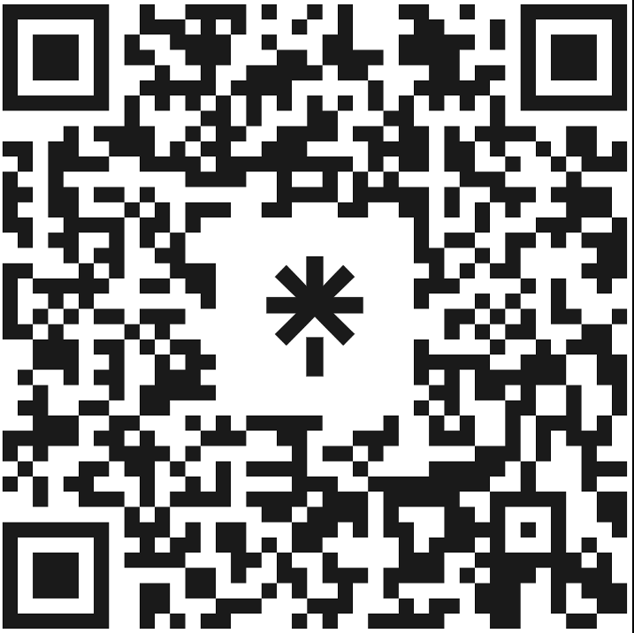
Scan this QR Code

Slide 43
Thank You!

